Slide 1
Quicklooks

Slide 2
Quicklook Slides
Presentation

Slide 3
Quicklook Interactive Webpages
Each application will have a Jupyter Notebook webpage with interactive maps and figures of SAR examples. The webpage will describe how to interpret and view SAR data for that specific application.
Information included on the webpage:
Qualitative Browse Variables (How does the user know there is something in the image related to this purpose *before* they develop/implement any algorithms?)
Wavelength(s)
Useful Products (polarization, InSAR, coherence, etc.)
Relevant Sensors
Instructions to View (RGB combo/gray scale)
Interpretation

Slide 4
Planned Application Areas
Biomass | Landslide Scar Mapping
Crop Type | Oil Spill
Deformation of land ice, ridge delineation, surface roughness | Open Water
Flood Area Extent | Sea Ice (concentration, type, multi-year vs new, floe size)
Flood Change Detection | Soil Moisture
Forest Disturbance | Vegetation Moisture Status
Forest Fire Extent | Volcano Eruption (lava extent, damage mapping, changes in vent)
Land Cover | Wave height in the marginal ice zone

Slide 5
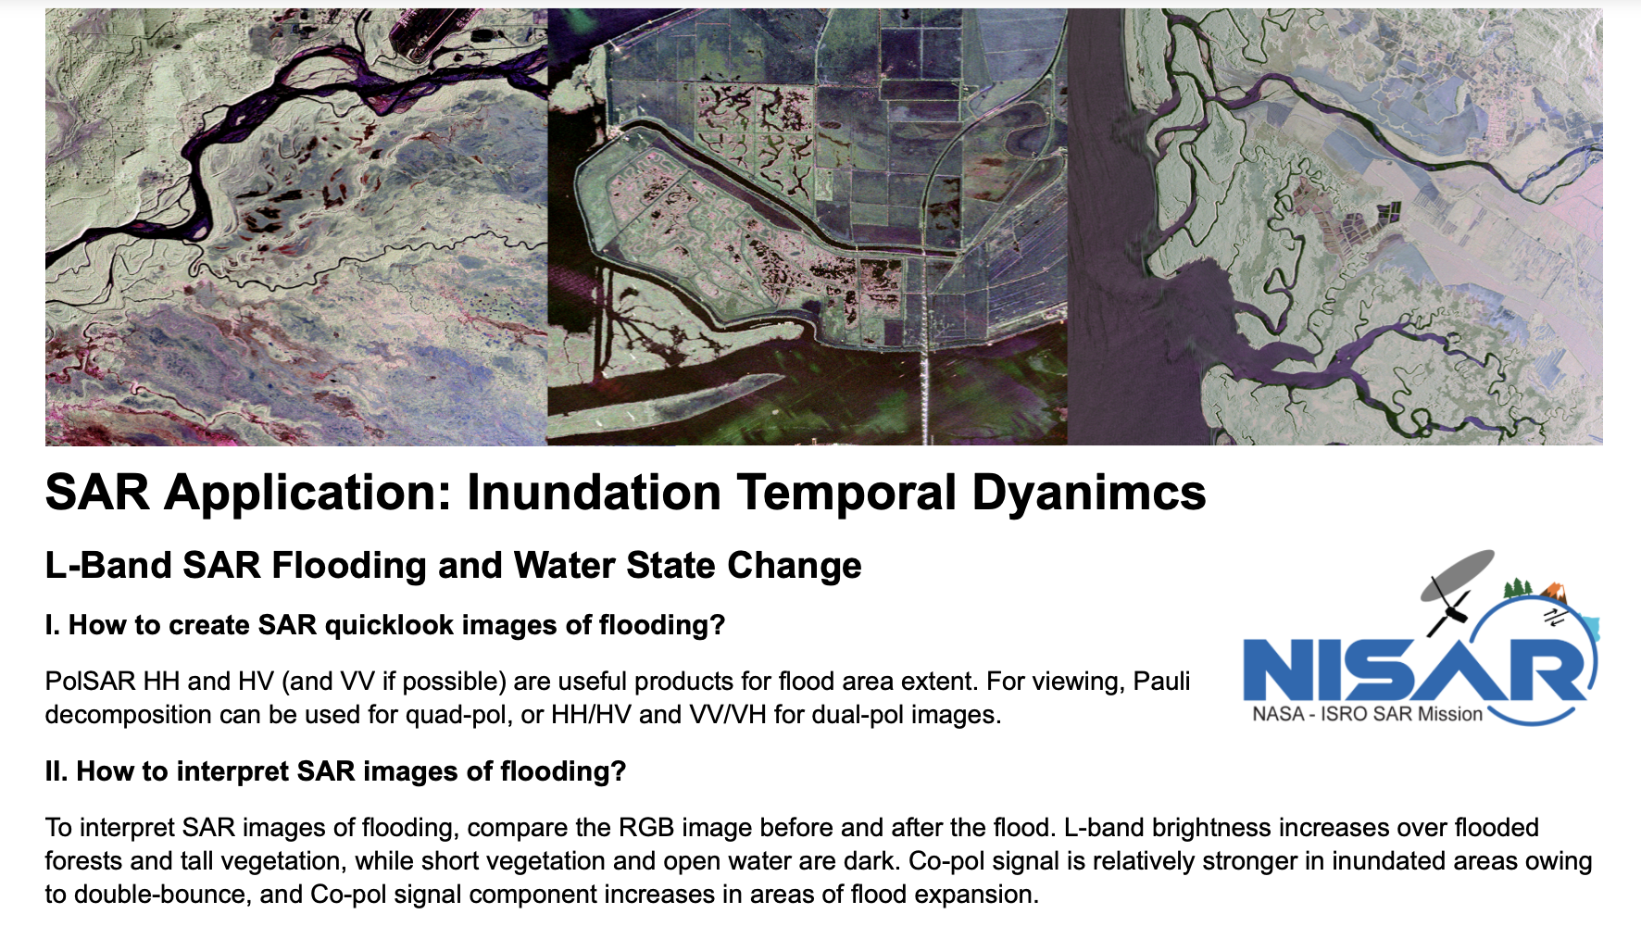
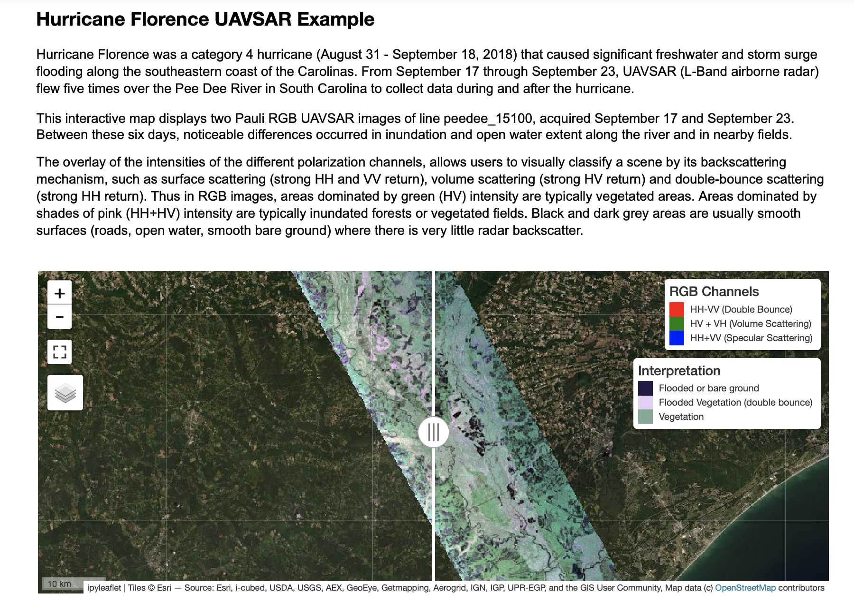
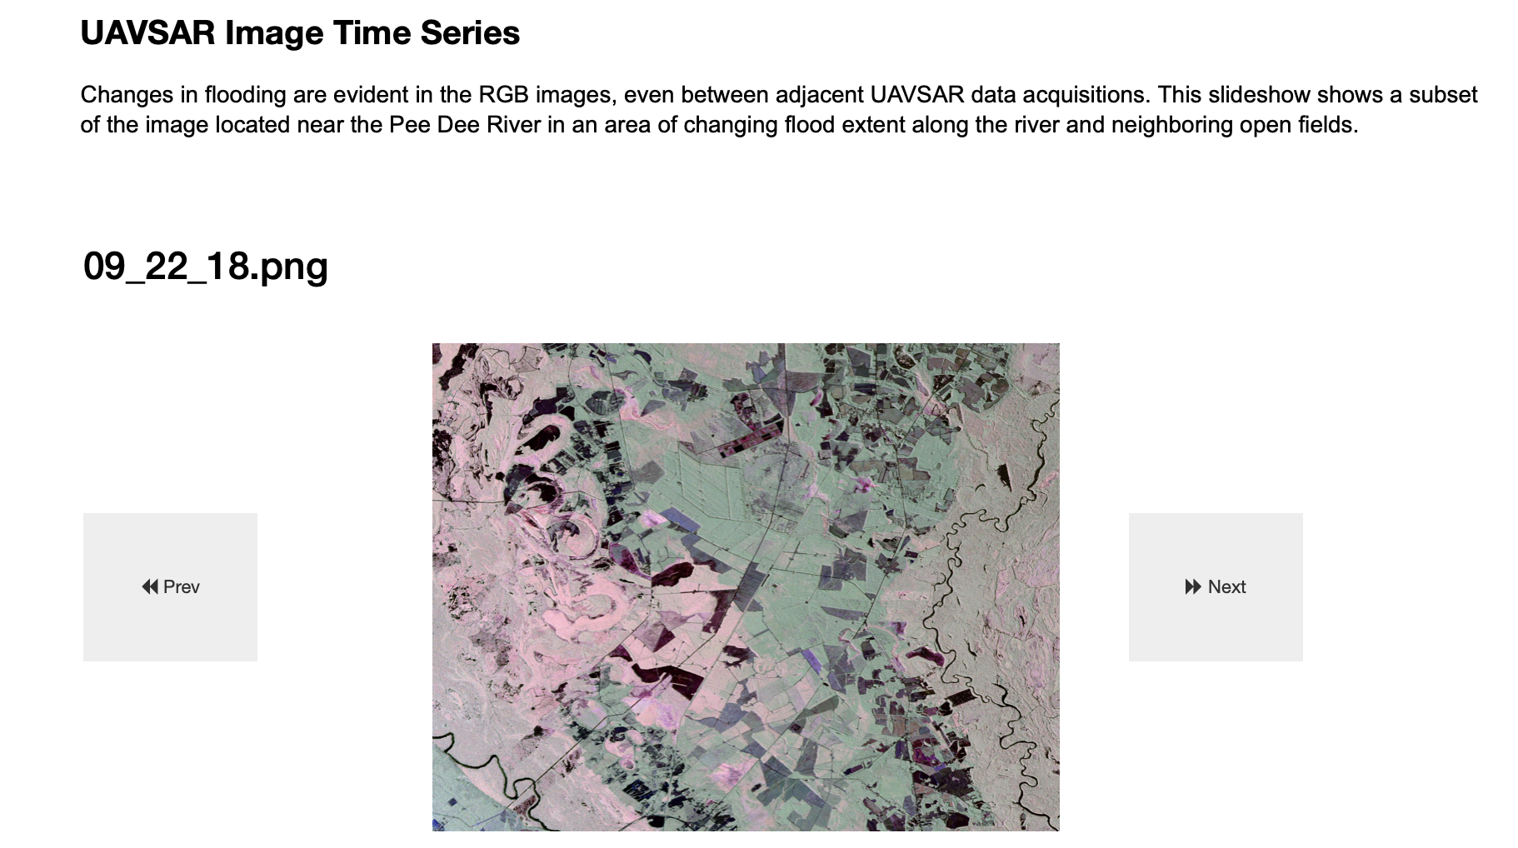
Example Webpage Layout
Section 1: Describe general processing and visualization guidelines for the application. Provide links to relevant tutorials and resources.
Section 2: Introduce a SAR example and describe how to interpret and display. This shows an interactive map of UAVSAR acquistions during and post Hurricane Florence flooding.
Section 3: Elaborate on the example. For this flooding example, we show a time series slideshow of the RGB images over a subset of the image.

Slide 6
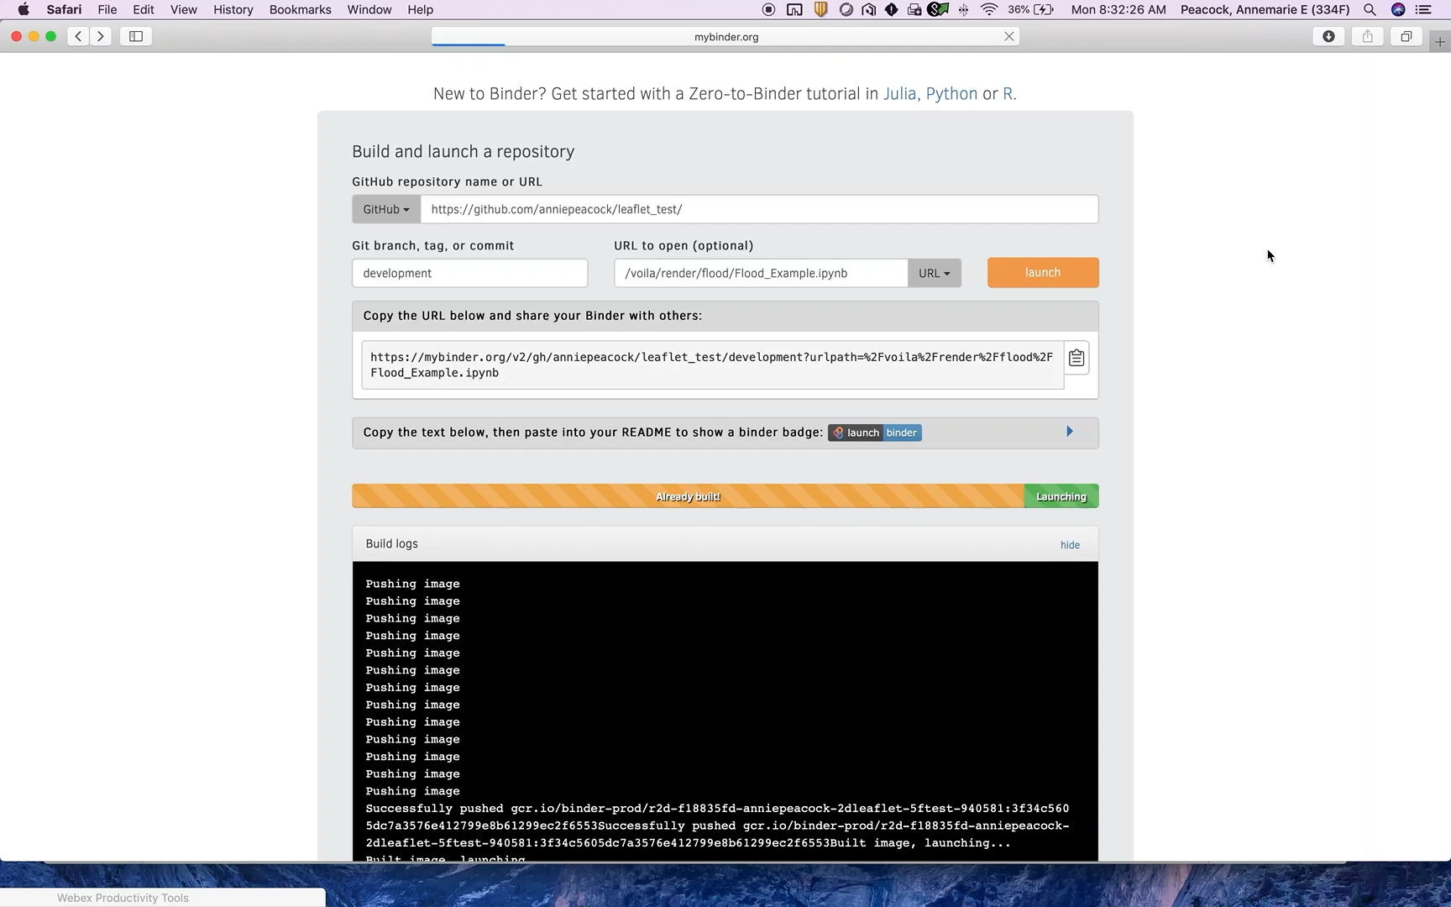
DEMO

Slide 7
03/10/21

Slide 8
3/10 Meeting
Fire Notebook Example
“To Do’s” for other 12 disciplines
Accessing / Sharing the Jupyter Notebooks

Slide 9
To Do:
Biomass
Generate HV/HV ratios over Station Fire recovery
Radar Vegetation Index (RVI) over Station Fire
Crop Classification
Read in HV backscatter and plot HV backscatter time series
Flood
Read in Hurricane Florence Coherence Image
Compare Coherence and Pauli RGBs with Optical Imagery
Forest Disturbance
Read in Napa Valley Coherence Image
Create HV or HH time series Napa Valley
Landslide
Thomas Fire Example or Big Sur Example
Oil Spill
Generate HH/HV backscatter ratio for Gulf Coast
Create slideshow of same-day acquisitions HH/VV Norway Oil Spill
Open Water
Read in HH Panama Subset – convert to decibels, filter, generate histogram of backscatter
dB thresholding for water mask
Sea Ice
Read in subsets of UAVSAR line Intensity images in VV & HH to compare different types of sea ice
Soil Moisture
Slideshow of UAVSAR VV Power images over Tonzi Ranch
Insert corresponding AmeriFlux time series

Slide 10
Accessing Notebooks
Git clone Jupyter Notebooks from the rgb_fun and rgb_quant repos
Follow “readme_setup_environment.txt” to download needed python packages
Future sharing – can provide Jupyter Notebook file and link to data download (like ASF Data Recipes)
Google Colab – Jupyter Notebook environment run on the cloud

Slide 11
Meeting Yunling
12 qualitative products
1 semi-finished fire notebook and 3-4 more
Google Colab/Hosting

Slide 12

Color Wheel
HH-VV
(Double Bounce)
HV+VH
(Volume Scattering)
HH+VV
(Surface Scattering)

Slide 14
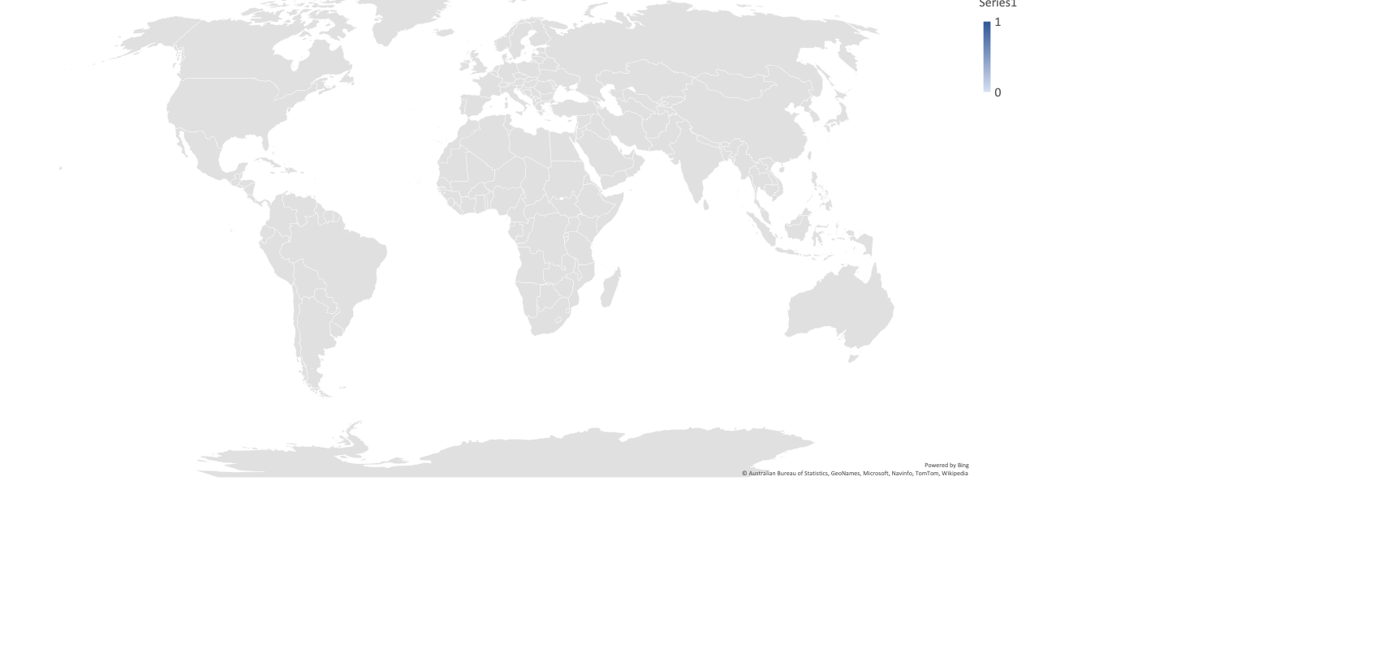

Slide 24
Notes:
Thomas Fire Landslides

Slide 25
02/09/21

Slide 26
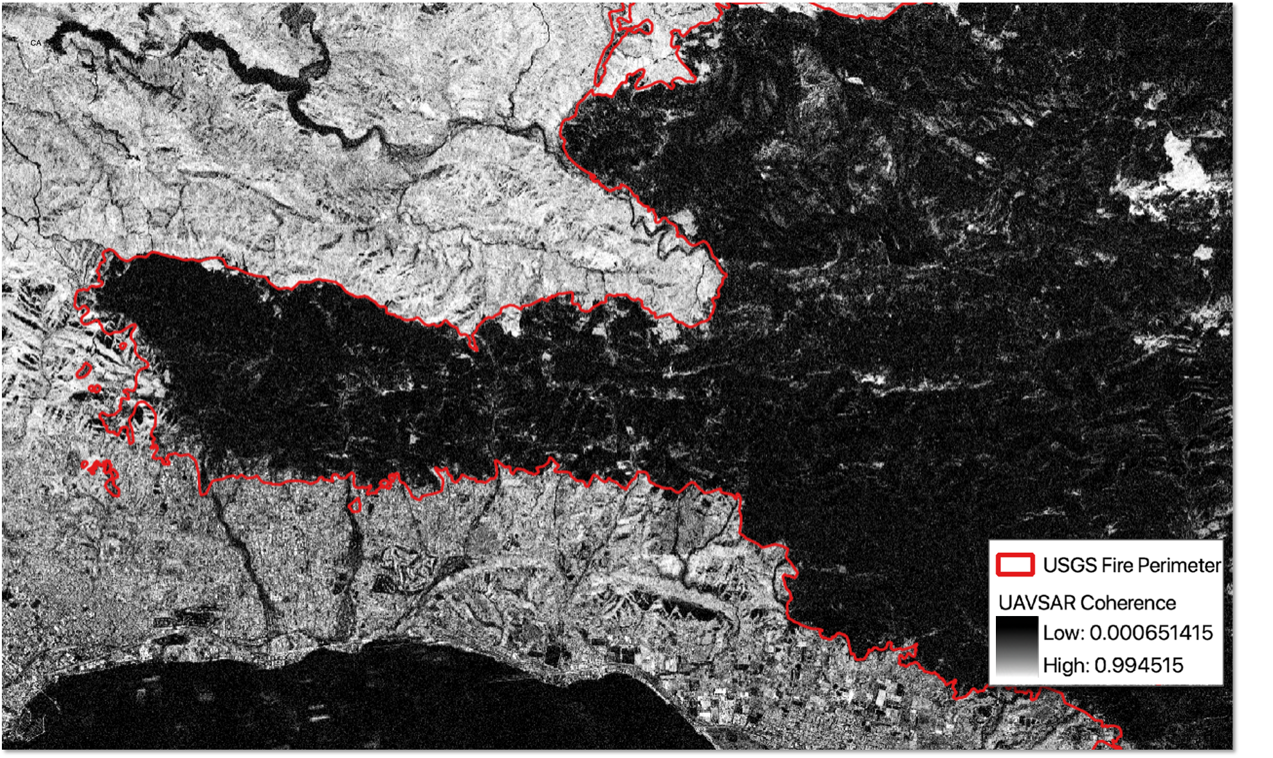
Thomas Fire Scar
Debris Flows
Pacific Ocean

Slide 27
# | SAR Application | UAVSAR Example | Products
1 | Forest Fire Extent | La Tuna Fire in the Verdugo Mountains, Thomas Fire Coherence | RGB, Coherence
2 | Forest Disturbance | Amazon Gold Mining, Napa Valley Deforestation, Mammoth Tree Die Off | RGB, Coherence
3 | Biomass | Station Fire | What product? (HV/HV different dates or RGB over gradients in vegetation density)
4 | Sea Ice | Beaufort Sea | Intensity Images VV, HH
5 | Surface Water Extent (delineation of inland water bodies or other calm water) | Panama Canal | RGB
6 | Flooding | Hurricane Florence | RGB, Coherence
7 | Landslide | Thomas Fire’s Montecito Debris Flows | Coherence
8 | Urban Areas | Munich, Quebec, San Diego, New Orleans | RGB
9 | Oil Spill | Gulf Coast, North Sea | What product?
10 | Soil Moisture | SMAPVEX Canada | What product?
11 | Crop Classification (annual crops) | Central Valley-San Joaquin Time Series | What product?
12 | Wetland Extent and Inundationo (Delineation) | Balona Wetland, Marsh Island, Fay Slough Wildlife Area, Sierpe Mangroves | RGB
https://docs.google.com/spreadsheets/d/1maIwaa0ebyg2Kx8cFDtL_JGIoV_pOgXUIyYO_X8LxEY/edit?usp=sharing

Slide 28
What is UAVSAR Pauli Decomposition?
What processing steps necessary for PolSAR (soil moisture, agriculture)?
Speckle? Multi-Look? Radiometric Calibration? Intensity vs. Power vs. Amplitude?
Geometry corrections necessary?

Slide 29
Forest Fire Extent
Link References
Make Coherence a slideshow? Pre-Fire HV, Post-Fire HV, Coherence
Verdugo Mountains Extent: [-118.3907205 ,34.16709426, -118.19881626,34.27160262]

Slide 30
Flooding
Make Coherence – Possibly add to interactive map?
Otherwise, make own subset/interactive slideshow to highlight coherence
Tiles in Pauli Map are switched around …. Fix

Slide 31
Crop Flooding
exec bash (set to bash)
for i in *.grd; do gdal_translate -projwin -79.50 34.042 -79.3507 33.9462 $i $i.tif; done
gdal_translate -projwin -79.50 34.042 -79.3507 33.9462 coherence.tif coherence_subset.tif

Slide 32
Soil Moisture
Have Tonzi Ranch VV GRD for 4 dates – even out brightness? Find a better scaling?
For Soil and Flux plots – the website is not too customizable – download data and make new plots with time of UAVSAR acquistions noted on plots
Clip:
for i in *.grd; do gdal_translate -projwin -120.968 38.433 -120.964 38.430 $i $i.tif; done
Tonzi Ranch: 38.4309, -120.9660

Slide 33
Crops
Cut to Stockton subset area [minx, maxx, miny, maxy = ]
Figure 6 extent: -121.5198, -121.3487, 37.8420, 37.9766
How to best show Fig 6 components with Pauli RGB?
HV time series and Fig 3 – preprocessing of HV data? Currently a little dark with the stretching

Slide 34
Crops clip shapefile
ogr2ogr -f "ESRI Shapefile" alfalfa_2010_re.shp alfalfa_2010.shp -s_srs EPSG:5070 -t_srs EPSG:4326
ogr2ogr -f "ESRI Shapefile" alfalfa_2010_re.shp alfalfa_2010.shp -s_srs EPSG:5070 -t_srs EPSG:4326
ogr2ogr -f "ESRI Shapefile" alfalfa_2010_re.shp alfalfa_2010.shp -s_srs EPSG:5070 -t_srs EPSG:4326
ogr2ogr -f "ESRI Shapefile" alfalfa_2010_re.shp alfalfa_2010.shp -s_srs EPSG:5070 -t_srs EPSG:4326
ogr2ogr -f "ESRI Shapefile" winterwheat_2010_re.shp winterwheat_2010.shp -s_srs EPSG:5070 -t_srs EPSG:4326
ogr2ogr -f "ESRI Shapefile" corn_2010_re.shp corn_2010.shp -s_srs EPSG:5070 -t_srs EPSG:4326
ogr2ogr -clipsrc -121.5198 37.94 -121.42 37.878 alfalfa_2010_clip.shp alfalfa_2010_re.shp
ogr2ogr -clipsrc -121.5198 37.94 -121.42 37.878 winterwheat_2010_clip.shp winterwheat_2010_re.shp
ogr2ogr -clipsrc -121.5198 37.94 -121.42 37.878 corn_2010_clip.shp corn_2010_re.shp

Slide 35
Crops (smaller subset)
gdal_translate SDelta_23520_10007_002_100114_L090HVHV_CX_01.grd SDelta_23520_100114_HV.tif -projwin -121.5198 37.94 -121.42 37.878
gdal_translate SDelta_23520_10025_005_100303_L090HVHV_CX_01.grd SDelta_23520_100303_HV.tif -projwin -121.5198 37.94 -121.42 37.878
gdal_translate SDelta_23520_10026_002_100409_L090HVHV_CX_01.grd SDelta_23520_100409_HV.tif -projwin -121.5198 37.94 -121.42 37.878
gdal_translate SDelta_23520_10036_002_100510_L090HVHV_CX_01.grd SDelta_23520_100510_HV.tif -projwin -121.5198 37.94 -121.42 37.878
gdal_translate SDelta_23520_10051_002_100617_L090HVHV_CX_01.grd SDelta_23520_100617_HV.tif -projwin -121.5198 37.94 -121.42 37.878
gdal_translate SDelta_23520_10059_008_100712_L090HVHV_CX_01.grd SDelta_23520_100712_HV.tif -projwin -121.5198 37.94 -121.42 37.878
gdal_translate SSDelta_23520_10070_002_100925_L090HVHV_CX_01.grd SDelta_23520_100925_HV.tif -projwin -121.5198 37.94 -121.42 37.878
gdal_translate SDelta_23520_10068_002_100810_L090HVHV_CX_01.grd SDelta_23520_100810_HV.tif -projwin -121.5198 37.94 -121.42 37.878
gdal_translate SDelta_23520_10075_003_101025_L090HVHV_CX_01.grd SDelta_23520_101025_HV.tif -projwin -121.5198 37.94 -121.42 37.878
gdal_translate SDelta_23520_10083_002_101130_L090HVHV_CX_01.grd SDelta_23520_101130_HV.tif -projwin -121.5198 37.94 -121.42 37.878

Slide 36
Crops (larger area expanding further North
gdal_translate SDelta_23520_10007_002_100114_L090HVHV_CX_01.grd SDelta_23520_100114_HV.tif -projwin -121.5198 37.9766 -121.42 37.878
gdal_translate SDelta_23520_10025_005_100303_L090HVHV_CX_01.grd SDelta_23520_100303_HV.tif -projwin -121.5198 37.9766 -121.42 37.878
gdal_translate SDelta_23520_10026_002_100409_L090HVHV_CX_01.grd SDelta_23520_100409_HV.tif -projwin -121.5198 37.9766 -121.42 37.878
gdal_translate SDelta_23520_10036_002_100510_L090HVHV_CX_01.grd SDelta_23520_100510_HV.tif -projwin -121.5198 37.9766 -121.42 37.878
gdal_translate SDelta_23520_10051_002_100617_L090HVHV_CX_01.grd SDelta_23520_100617_HV.tif -projwin -121.5198 37.9766 -121.42 37.878
gdal_translate SDelta_23520_10059_008_100712_L090HVHV_CX_01.grd SDelta_23520_100712_HV.tif -projwin -121.5198 37.9766 -121.42 37.878
gdal_translate SSDelta_23520_10070_002_100925_L090HVHV_CX_01.grd SDelta_23520_100925_HV.tif -projwin -121.5198 37.9766 -121.42 37.878
gdal_translate SDelta_23520_10068_002_100810_L090HVHV_CX_01.grd SDelta_23520_100810_HV.tif -projwin -121.5198 37.9766 -121.42 37.878
gdal_translate SDelta_23520_10075_003_101025_L090HVHV_CX_01.grd SDelta_23520_101025_HV.tif -projwin -121.5198 37.9766 -121.42 37.878
gdal_translate SDelta_23520_10083_002_101130_L090HVHV_CX_01.grd SDelta_23520_101130_HV.tif -projwin -121.5198 37.9766 -121.42 37.878

Slide 37
Open Water
Redo Panama tiles (for transparency) – add markers with different fields – i.e. open water, agricultural fields, inundation
Python clickable graphic? That generates chart of values at different locations?
## Read in Panama Subset
## Histograms and threshold different values to show changes (Fire has a partial thresholding example, may need to speckle filter first)

Slide 38
Open Water

Slide 39
Forest Disturbance
Add more text descriptions
Napa Valley Coherence
-projwin ulx uly lrx lry
gdal_translate SanAnd_23513_16034-006_17021-002_0343d_s01_L090HH_01.cor.grd.tif SanAnd_23513_16034-006_17021-002_0343d_s01_L090HH_01_cropped.cor.grd.tif -projwin -122.413386 38.5436307 -122.2252091 38.405

Slide 40
Oil Spill
Make HH/VV backscatter ratio (what processing should do first?)
Slideshow for Norway with backscatter ratio
Convert to sigma naught or dB
Gulf Coast Oil Spill Line 1:
gdal_translate gulfco_14010_10054_100_100623_L090HHHH_CX_04.grd gulfco_14010_100623_HH.tif -projwin -88.948 29.154 -88.132 28.601
gdal_translate gulfco_14010_10054_100_100623_L090VVVV_CX_04.grd gulfco_14010_100623_VV.tif -projwin -88.948 29.154 -88.132 28.601
Gulf Coast Oil Spill Line 2:
gdal_translate gulfco_32010_10054_101_100623_L090HHHH_CX_04.grd gulfco_32010_100623_HH.tif -projwin -88.948 29.154 -88.132 28.477
gdal_translate gulfco_32010_10054_101_100623_L090VVVV_CX_04.grd gulfco_32010_100623_VV.tif -projwin -88.948 29.154 -88.132 28.477

Slide 41
Oil Spill (subset further)
## Upper oil slick
gdal_translate gulfco_14010_100623_HH.tif gulfco_14010_100623_HH_usubset.tif -projwin -88.743 29.086 -88.581 28.959
gdal_translate gulfco_14010_100623_VV.tif gulfco_14010_100623_VV_usubset.tif -projwin -88.743 29.086 -88.581 28.959
## Lower oil slick
gdal_translate gulfco_14010_100623_HH.tif gulfco_14010_100623_HH_lsubset.tif -projwin -88.5093 28.8416 -88.3539 28.6983
gdal_translate gulfco_14010_100623_VV.tif gulfco_14010_100623_VV_lsubset.tif -projwin -88.5093 28.8416 -88.3539 28.6983

Slide 42
Norway Oil Spill
Gulf Coast Oil Spill Line 1:
gdal_translate norway_00709_15091_014_150610_L090VVVV_CX_01.grd norway_00709_150610_014_VV.tif -projwin 2.1201 60.0954 2.2745 59.8668
gdal_translate norway_00709_15091_014_150610_L090HHHH_CX_01.grd norway_00709_150610_014_HH.tif -projwin 2.1201 60.0954 2.2745 59.8668
gdal_translate norway_00709_15091_008_150610_L090VVVV_CX_01.grd norway_00709_150610_008_VV.tif -projwin 2.1201 60.0954 2.2745 59.8668
gdal_translate norway_00709_15091_008_150610_L090HHHH_CX_01.grd norway_00709_150610_008_HH.tif -projwin 2.1201 60.0954 2.2745 59.8668
gdal_translate norway_00709_15091_000_150610_L090VVVV_CX_01.grd norway_00709_150610_000_VV.tif -projwin 2.1201 60.0954 2.2745 59.8668
gdal_translate norway_00709_15091_000_150610_L090HHHH_CX_01.grd norway_00709_150610_000_HH.tif -projwin 2.1201 60.0954 2.2745 59.8668
gdal_translate norway_00709_15091_000_150610_L090HVHV_CX_01.grd norway_00709_150610_000_HV.tif -projwin 2.1201 60.0954 2.2745 59.8668

Slide 43
Norway Oil Spill (smaller subset)
Gulf Coast Oil Spill Line 1:
for i in *.tif; do gdal_translate -projwin 2.127 60.055 2.271 59.925 $i $i.tif; done

Slide 44
Wetland Inundation
Make slideshow from Bonanza Creek
Bonanza Creek Extent [﻿-148.1640, -147.9379, 64.66, 64.7707]

Slide 45
Biomass Station Fire Subset 08527
gdal_translate SanAnd_08527_10072_007_101014_L090HHHH_CX_02.grd SanAnd_08527_10072_007_101014_L090HHHH_CX_02.tif -projwin -118.333 34.4618 -118.0558 34.3257
exec bash (set to bash)
for i in *.grd; do gdal_translate -projwin -118.3 34.4618 -118.15 34.34 $i $i.tif; done

Slide 46
Biomass Create Station Fire Subset (larger)
gdal_translate SanAnd_08525_09072_002_090918_L090HVHV_CX_02.grd SanAnd_08525_090918_HVHV.tif -projwin -118.1259 34.3167 -117.9165 34.2000
gdal_translate SanAnd_08525_10072_005_101014_L090HVHV_CX_02.grd SanAnd_08525_101014_HVHV.tif -projwin -118.1259 34.3167 -117.9165 34.2000
gdal_translate SanAnd_08525_12134_001_121115_L090HVHV_CX_01.grd SanAnd_08525_121115_HVHV.tif -projwin -118.1259 34.3167 -117.9165 34.2000
gdal_translate SanAnd_08525_14158_003_141023_L090HVHV_CX_01.grd SanAnd_08525_141023_HVHV.tif -projwin -118.1259 34.3167 -117.9165 34.2000
gdal_translate SanAnd_08525_17122_003_171102_L090HVHV_CX_01.grd SanAnd_08525_171102_HVHV.tif -projwin -118.1259 34.3167 -117.9165 34.2000
gdal_translate SanAnd_08525_18076_003_181011_L090HVHV_CX_01.grd SanAnd_08525_181011_HVHV.tif -projwin -118.1259 34.3167 -117.9165 34.2000
gdal_translate SanAnd_08525_20026_016_200918_L090HVHV_CX_01.grd SanAnd_08525_200918_LHVHV.tif -projwin -118.1259 34.3167 -117.9165 34.2000

Slide 47
Biomass Create Station Fire Subset (smaller)
gdal_translate SanAnd_2020_HV.tif SanAnd_2020_HV_subset.tif -projwin -118.1259 34.29 -117.93 34.2092
gdal_translate SanAnd_2018_HV.tif SanAnd_2018_HV_subset.tif -projwin -118.1259 34.29 -117.93 34.2092
gdal_translate SanAnd_2009_HV.tif SanAnd_2009_HV_subset.tif -projwin -118.1259 34.29 -117.93 34.2092
gdal_translate SanAnd_2010_HV.tif SanAnd_2010_HV_subset.tif -projwin -118.1259 34.29 -117.93 34.2092
gdal_translate SanAnd_2012_HV.tif SanAnd_2012_HV_subset.tif -projwin -118.1259 34.29 -117.93 34.2092
gdal_translate SanAnd_2014_HV.tif SanAnd_2014_HV_subset.tif -projwin -118.1259 34.29 -117.93 34.2092
gdal_translate SanAnd_2017_HV.tif SanAnd_2017_HV_subset.tif -projwin -118.1259 34.29 -117.93 34.2092

Slide 48
Biomass - Convert to decibels
gdal_calc.py -A SanAnd_2009_HV.tif --outfile=2009_db.tif --calc="10*log10(A)"
gdal_calc.py -A SanAnd_2010_HV.tif --outfile=2010_db.tif --calc="10*log10(A)"
gdal_calc.py -A SanAnd_2017_HV.tif --outfile=2017_db.tif --calc="10*log10(A)"
gdal_calc.py -A SanAnd_2012_HV.tif --outfile=2012_db.tif --calc="10*log10(A)"
gdal_calc.py -A SanAnd_2014_HV.tif --outfile=2014_db.tif --calc="10*log10(A)"
gdal_calc.py -A SanAnd_2018_HV.tif --outfile=2018_db.tif --calc="10*log10(A)"
gdal_calc.py -A SanAnd_2020_HV.tif --outfile=2020_db.tif --calc="10*log10(A)"

Slide 49
Biomass HV/HV ratio
gdal_calc.py -A 2009_db.tif -B 2010_db.tif --outfile=2009_2010.tif --calc="(A/B)"
gdal_calc.py -A 2009_db.tif -B 2012_db.tif --outfile=2009_2012.tif --calc="(A/B)"
gdal_calc.py -A 2009_db.tif -B 2014_db.tif --outfile=2009_2014.tif --calc="(A/B)"
gdal_calc.py -A 2009_db.tif -B 2017_db.tif --outfile=2009_2017.tif --calc="(A/B)"
gdal_calc.py -A 2009_db.tif -B 2018_db.tif --outfile=2009_2018.tif --calc="(A/B)"
gdal_calc.py -A 2009_db.tif -B 2020_db.tif --outfile=2009_2020.tif --calc="(A/B)"
Notes:
2009 / another year. The ratio images were created from decibels. In areas of lower HV, decibels are more negative and higher HV backscatter increases. Therefore, if the ratio has a larger value, HV was lower in 2009 or just after the fire. For example, if a burnt pixel was -25 db in 2009 and -5 db in 2014, 5 years later. The ratio would be 5. We expect the HV/HV ratio to increase as the burnt area regenerates after the fire.
In the station fire extent, would expect the 2010 ratio to

Slide 50
OLD Biomass HV/HV ratio – should convert to decibels before taking ratio?
gdal_calc.py -A SanAnd_2009_HV.tif -B SanAnd_2010_HV.tif --outfile=2009_2010.tif --calc="(A/B)"
gdal_calc.py -A SanAnd_2009_HV.tif -B SanAnd_2012_HV.tif --outfile=2009_2012.tif --calc="(A/B)"
gdal_calc.py -A SanAnd_2009_HV.tif -B SanAnd_2014_HV.tif --outfile=2009_2014.tif --calc="(A/B)”
gdal_calc.py -A SanAnd_2009_HV.tif -B SanAnd_2017_HV.tif --outfile=2009_2017.tif --calc="(A/B)”
gdal_calc.py -A SanAnd_2009_HV.tif -B SanAnd_2018_HV.tif --outfile=2009_2018.tif --calc="(A/B)"
gdal_calc.py -A SanAnd_2009_HV.tif -B SanAnd_2020_HV.tif --outfile=2009_2020.tif --calc="(A/B)"
Notes:
2009 / another year. Therefore, if the ratio has a larger value, HV was greater in 2009 or just after the fire. In the station fire extent, would expect the 2010 ratio to

Slide 51
01/15/21

Slide 52
GitHub Repo: nspinto/rgb_fun/development
13 Folders – one for each SAR Application + Template Folder
Template Folder:
Application webpage template
Application python data analysis template
In each application folder:
Application.ipynb
Will have more thorough written descriptions of products and interpretations
Images, Interactive slideshow, interactive map etc.
Application_data.ipynb (can eventually be accessible through binder link)
Jupyter Notebook that reads in and creates RGB or other simple data product / analyses
Uavsar_data
Contains the cropped UAVSAR geotiffs
Pictures/Pics
Relevant pictures for webpage
Tiles folder
For webpages’ interactive map, need to generate image tiles. They are stored in these folders.

Slide 53
# | SAR Application | UAVSAR Example | Products
1 | Forest Fire Extent | La Tuna Fire in the Verdugo Mountains, Thomas Fire Coherence | RGB, Coherence
2 | Forest Disturbance | Amazon Gold Mining, Napa Valley Deforestation, Mammoth Tree Die Off | RGB, Coherence
3 | Biomass | Station Fire | What product? (HV/HV different dates or RGB over gradients in vegetation density)
4 | Sea Ice | Beaufort Sea | Intensity Images VV, HH
5 | Surface Water Extent | Panama Canal | RGB
6 | Inundation Temporal Dynamics | Hurricane Florence | RGB, Coherence
7 | Landslide Scar | Thomas Fire’s Montecito Debris Flows | Coherence
8 | Urban Areas | Munich, Quebec, San Diego, New Orleans | RGB
9 | Oil Spill | Gulf Coast, North Sea | What product?
10 | Soil Moisture | SMAPVEX Canada | What product?
11 | Crop Classification | Central Valley-San Joaquin Time Series | What product?
12 | Wetland Delineation | Balona Wetland, Marsh Island, Fay Slough Wildlife Area, Sierpe Mangroves | RGB
https://docs.google.com/spreadsheets/d/1maIwaa0ebyg2Kx8cFDtL_JGIoV_pOgXUIyYO_X8LxEY/edit?usp=sharing

Slide 54
Subset Coordinates
# | SAR Application | UAVSAR Example | Extent -projwin ulx uly lrx lry
1 | Forest Fire Extent | La Tuna Fire in the Verdugo Mountains, Thomas Fire Coherence | La Tuna Fire: -118.3907, 34.2716, -118.1988, 34.1671 Thomas Fire Coherence: (not sure which part of image is best) -119.6930, 34.5291, -119.4642, 34.3941
2 | Forest Disturbance | Amazon Gold Mining, Napa Valley Deforestation, Mammoth Tree Die Off | Amazon: (Peru_overlap.shp) Further subset for size: -69.9862, -12.7717, -69.8823, -12.8219 Napa: -122.9069, 38.3360, -122.4451, 38.1726 Napa Coherence: Mammoth: -119.0947, 37.6823, -118.9565, 37.5862 (mammoth shapefile)
4 | Sea Ice | Beaufort Sea | Beaufort Subset:
5 | Surface Water Extent | Panama Canal | Panama Subset: (what part of the image is best?) -79.8928, 9.0897, -79.8064, 9.0246
6 | Inundation Temporal Dynamics | Hurricane Florence | Hurricane Florence Subset: (which part of image is best) -79.5524, 34.0554, -79.3462, 33.8931 Hurricane Florence Coherence Subset: have coherence image
7 | Landslide Scar | Thomas Fire’s Montecito Debris Flows | Thomas Fire:

Slide 55
Questions
Should the files be intensity, dB, complex ….. ?

Slide 56
# | SAR Application | UAVSAR Example | UAVSAR Downloaded?
1 | Forest Fire Extent | La Tuna Fire in the Verdugo Mountains, Thomas Fire Coherence | 2014 Image: https://uavsar.jpl.nasa.gov/cgi-bin/product.pl?jobName=SanAnd_08525_14158_003_141023_L090_CX_01#data 2017 Image: https://uavsar.jpl.nasa.gov/cgi-bin/product.pl?jobName=SanAnd_08525_17122_003_171102_L090_CX_01#data Thomas Coherence: https://uavsar.jpl.nasa.gov/cgi-bin/product.pl?jobName=SanAnd_26530_17122-002_18001-007_0095d_s01_L090_02
2 | Forest Disturbance | Amazon Gold Mining, Napa Valley Deforestation, Mammoth Tree Die Off | Amazon 2013: https://uavsar.jpl.nasa.gov/cgi-bin/product.pl?jobName=PeruMd_25602_13050_001_130330_L090_CX_01#data Amazon 2014: https://uavsar.jpl.nasa.gov/cgi-bin/product.pl?jobName=PeruMd_25604_14057_001_140501_L090_CX_01#data Mammoth: https://uavsar.jpl.nasa.gov/cgi-bin/product.pl?jobName=lngvly_35504_14142_004_141007_L090_CX_01#data Napa Coherence: https://uavsar.jpl.nasa.gov/cgi-bin/product.pl?jobName=SanAnd_23513_16034-006_17021-002_0343d_s01_L090_01#data Napa March 2016: https://uavsar.jpl.nasa.gov/cgi-bin/product.pl?jobName=SanAnd_23513_16034_006_160325_L090_CX_01#data Napa March 2017: https://uavsar.jpl.nasa.gov/cgi-bin/product.pl?jobName=SanAnd_23513_17021_002_170303_L090_CX_01#data
3 | Biomass | Station Fire
4 | Sea Ice | Beaufort Sea | https://uavsar.jpl.nasa.gov/cgi-bin/product.pl?jobName=beaufo_01104_15148_000_151006_L090_CX_03#data (VV and HH)
5 | Surface Water Extent | Panama Canal | Panama: https://uavsar.jpl.nasa.gov/cgi-bin/product.pl?jobName=PCanal_31504_10017_010_100206_L090_CX_02#data
6 | Inundation Temporal Dynamics | Hurricane Florence | Sept 17: https://uavsar.jpl.nasa.gov/cgi-bin/product.pl?jobName=peedee_15100_18064_002_180917_L090_CX_01#data Sept 23: https://uavsar.jpl.nasa.gov/cgi-bin/product.pl?jobName=peedee_15100_18069_007_180923_L090_CX_01#data Coherence: https://uavsar.jpl.nasa.gov/cgi-bin/product.pl?jobName=peedee_15100_18067-005_18068-005_0002d_s01_L090_01#data
7 | Landslide Scar | Thomas Fire’s Montecito Debris Flows | Thomas Coherence: https://uavsar.jpl.nasa.gov/cgi-bin/product.pl?jobName=SanAnd_26530_17122-002_18001-007_0095d_s01_L090_02
8 | Urban Areas | Munich, Quebec, San Diego, New Orleans | Munich: https://uavsar.jpl.nasa.gov/cgi-bin/product.pl?jobName=munich_19417_15088_002_150605_L090_CX_01#data San Diego SanAnd_08503 (many collections); New Orleans gulfco_09010 (many collections)
9 | Oil Spill | Gulf Coast, North Sea | North Sea - lots of lines from different angles and repeats over 1-2 days. Norway_18709 (most amount of takes) https://uavsar.jpl.nasa.gov/cgi-bin/product.pl?jobName=norway_18709_15092_001_150610_L090_CX_01#data https://uavsar.jpl.nasa.gov/cgi-bin/product.pl?jobName=norway_18709_15091_001_150610_L090_CX_01#data
10 | Soil Moisture | SMAPVEX Canada
11 | Crop Classification | Central Valley-San Joaquin Time Series
12 | Wetland Delineation | Balona Wetland, Marsh Island, Fay Slough Wildlife Area, Sierpe Mangroves
Draft Complete – Needs Review
Need Some Help
Need More Help
https://docs.google.com/spreadsheets/d/1maIwaa0ebyg2Kx8cFDtL_JGIoV_pOgXUIyYO_X8LxEY/edit?usp=sharing

Slide 57
# | SAR Application | UAVSAR Example | Help
1 | Forest Fire Extent | La Tuna Fire in the Verdugo Mountains, Thomas Fire Coherence | RGB, Coherence
2 | Forest Disturbance | Amazon Gold Mining, Napa Valley Deforestation, Mammoth Tree Die Off | RGB, Coherence
3 | Biomass | Station Fire | What product? (HV/HV different dates or RGB over gradients in vegetation density)
4 | Sea Ice | Beaufort Sea | Intensity Images VV, HH
5 | Surface Water Extent | Panama Canal | RGB
6 | Inundation Temporal Dynamics | Hurricane Florence | RGB, Coherence
7 | Landslide Scar | Thomas Fire’s Montecito Debris Flows | Coherence
8 | Urban Areas | Munich, Quebec, San Diego, New Orleans | RGB
9 | Oil Spill | Gulf Coast, North Sea | What product?
10 | Soil Moisture | SMAPVEX Canada | What product?
11 | Crop Classification | Central Valley-San Joaquin Time Series | What product?
12 | Wetland Delineation | Balona Wetland, Marsh Island, Fay Slough Wildlife Area, Sierpe Mangroves | RGB
Draft Complete – Needs Review
Need Some Help
Need More Help
https://docs.google.com/spreadsheets/d/1maIwaa0ebyg2Kx8cFDtL_JGIoV_pOgXUIyYO_X8LxEY/edit?usp=sharing

Slide 58
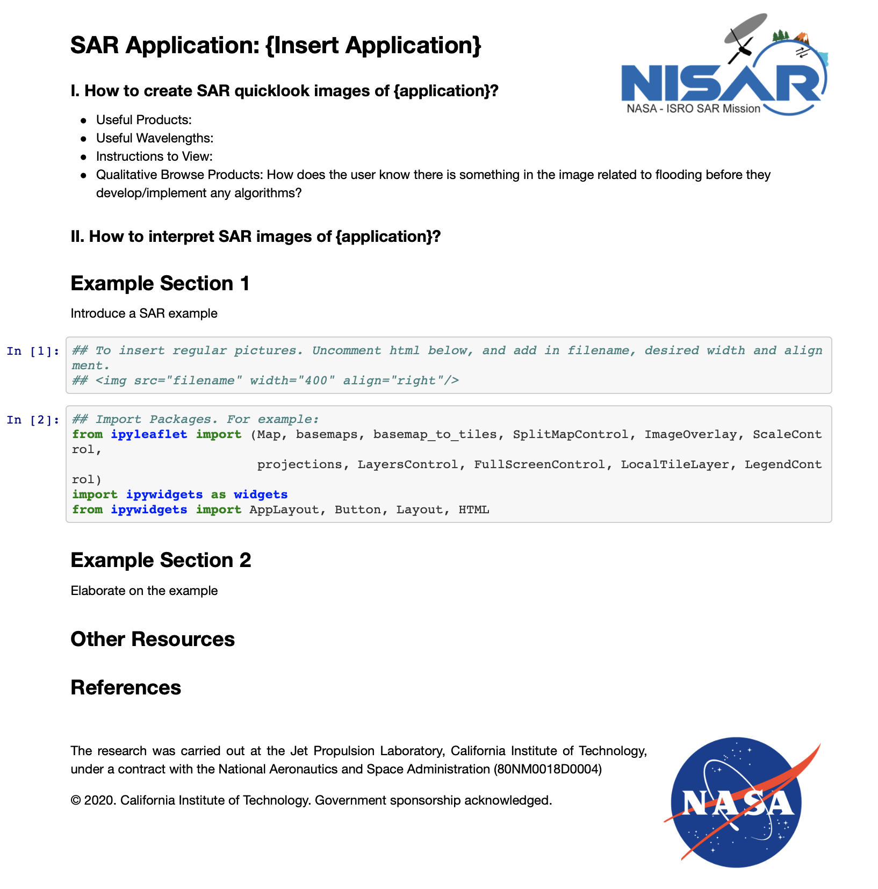
Template Layout
Section 1: Describe general processing and visualization guidelines for the application.
Section 2: Introduce a SAR example and describe how to interpret and display. Here I can include different code cells to fill in depending on desired visualization.
Visualizations could include:
interactive maps/graphs, histograms, etc. of different data products
Section 3: Provide another example or elaborate on another method/visualization
Section 4: Provide links to relevant tutorials and resources. List references.

Slide 59
Example Layout
Section 1: Describe general processing and visualization guidelines for the application. Provide links to relevant tutorials and resources.
Section 2: Introduce a SAR example and describe how to interpret and display. This shows an interactive map of UAVSAR acquisitions during and post Hurricane Florence flooding.
Section 3: Elaborate on the example. For this flooding example, a time series slideshow of the RGB images over a subset of the image.
Notes:
https://nisarquicklook.herokuapp.com/voila/render/Fire_Example.ipynb

Slide 60
10/28/20

Slide 61
Quicklook Interactive Webpages
Each science application would have a webpage with interactive maps and figures of SAR examples and some analysis with the data. The webpage will describe how to interpret and view SAR data for that specific application.
Information included on the webpage:
Qualitative Browse Variables (How does the user know there is something in the image related to this purpose *before* they develop/implement any algorithms?)
Wavelength(s)
Useful Products (polarization, InSAR, coherence, etc.)
Relevant Sensors
Instructions to View (RGB combo/gray scale)
Interpretation

Slide 62
# | SAR Application | UAVSAR Example | Help
1 | Forest Fire Extent | La Tuna Fire in the Verdugo Mountains, Thomas Fire Coherence
2 | Forest Disturbance | Amazon Gold Mining, Napa Valley Deforestation, Mammoth Tree Die Off
3 | Biomass | Station Fire
4 | Sea Ice | Beaufort Sea
5 | Surface Water Extent | Panama Canal
6 | Inundation Temporal Dynamics | Hurricane Florence
7 | Landslide Scar | Thomas Fire’s Montecito Debris Flows
8 | Urban Areas | Munich, Quebec, San Diego, New Orleans
9 | Oil Spill | Gulf Coast, North Sea
10 | Soil Moisture | SMAPVEX Canada
11 | Crop Classification | Central Valley-San Joaquin Time Series
12 | Wetland Delineation | Balona Wetland, Marsh Island, Fay Slough Wildlife Area, Sierpe Mangroves
Draft Complete – Needs Review
Need Some Help
Need More Help
https://docs.google.com/spreadsheets/d/1maIwaa0ebyg2Kx8cFDtL_JGIoV_pOgXUIyYO_X8LxEY/edit?usp=sharing

Slide 63
Template Layout
Section 1: Describe general processing and visualization guidelines for the application.
Section 2: Introduce a SAR example and describe how to interpret and display. Here I can include different code cells to fill in depending on desired visualization.
Visualizations could include:
interactive maps/graphs, histograms, etc. of different data products
Section 3: Provide another example or elaborate on another method/visualization
Section 4: Provide links to relevant tutorials and resources. List references.

Slide 64
Example Layout
Section 1: Describe general processing and visualization guidelines for the application. Provide links to relevant tutorials and resources.
Section 2: Introduce a SAR example and describe how to interpret and display. This shows an interactive map of UAVSAR acquistions during and post Hurricane Florence flooding.
Section 3: Elaborate on the example. For this flooding example, a time series slideshow of the RGB images over a subset of the image.
Notes:
https://nisarquicklook.herokuapp.com/voila/render/Fire_Example.ipynb

Slide 65
1) Jupyter Notebook
an open-source web application that allows you to create and share documents that contain live code, equations, visualizations and narrative text. Run locally.
2) Voila
Package that runs the Jupyter Notebook’s code, collects the outputs, and converts to HTML.
3) Deploy on Website?
Can we deploy Voila’s output on the UAVSAR website?

Slide 66
Hosting on UAVSAR Website
Test installed the python packages for my user account on trfic (jupyter notebook, ipyleaflet, ipywidgets, voila etc.)
Uploaded Jupyter Notebook files to trfic and ran them through Voila to generate HTML pages
Can these be publically deployed? From Voila documentation, deploying on a private server: https://voila.readthedocs.io/en/stable/deploy.html
According to internet, Voila can be deployed through trfic’s setup (Apache and CentOs7). Would need to convert nginx instructions to Apache

Slide 67
JPL Github
https://github.jpl.nasa.gov/nspinto/rgb_fun/tree/master
On “Development” Branch, folder with different applications

Slide 68
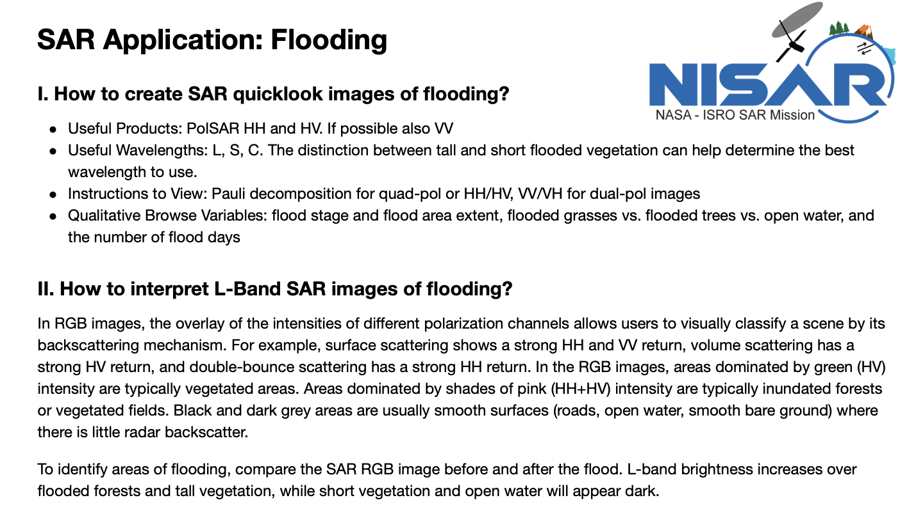
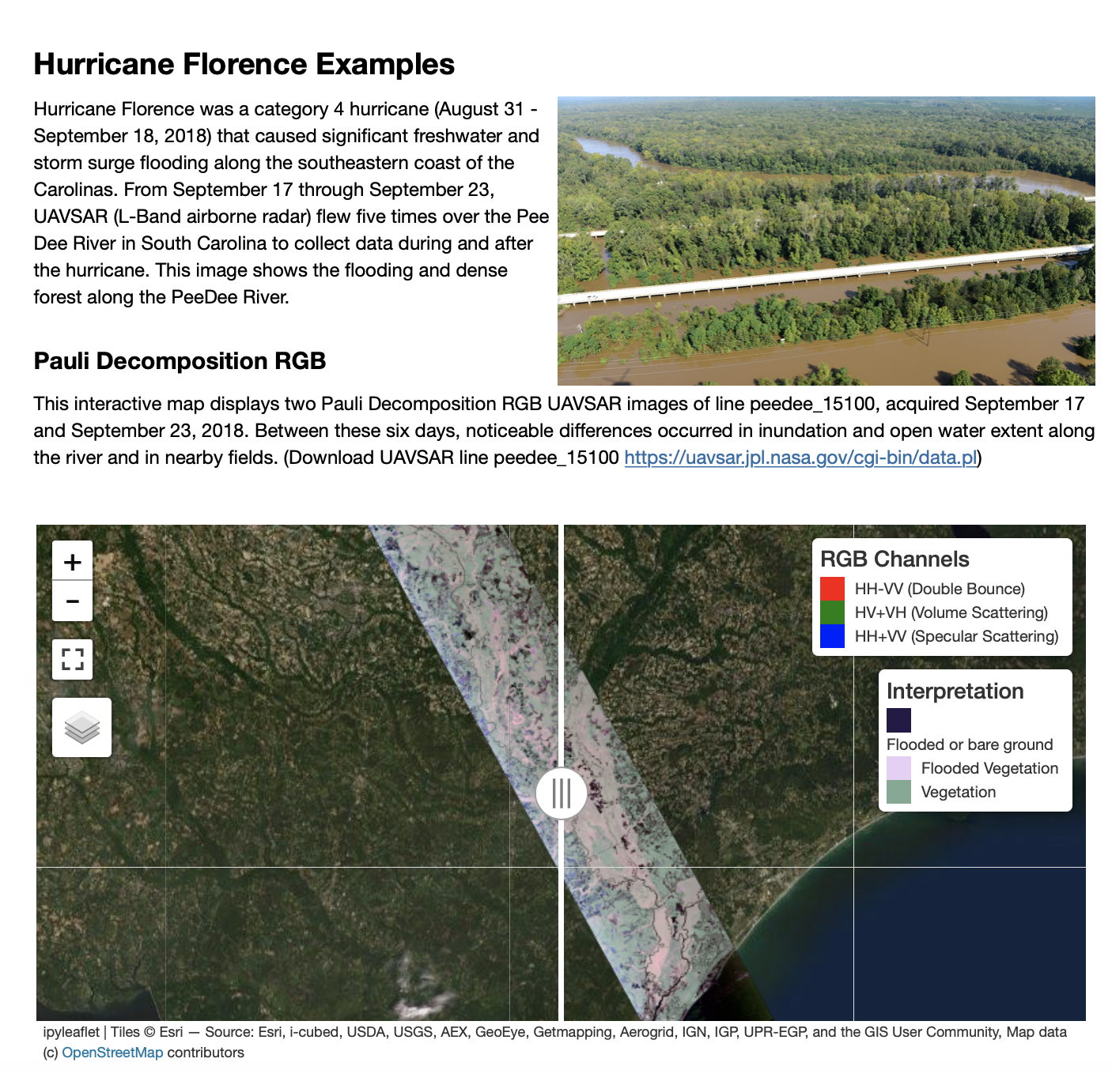
Flood Change Detection
Section 1: Describe general processing and visualization guidelines for Flood Application
Section 2: Introduce Hurricane Florence Example with site pictures. Interactive map comparing RGB during and Post flooding in North Carolina
Section 3: Elaborate on the example. For this flooding example, show a time series slideshow of the RGB images over a subset of the image. Also, coherence?
Flood: https://nisarquickloooks.herokuapp.com/voila/render/Flooding/Flood_Example.ipynb

Slide 69
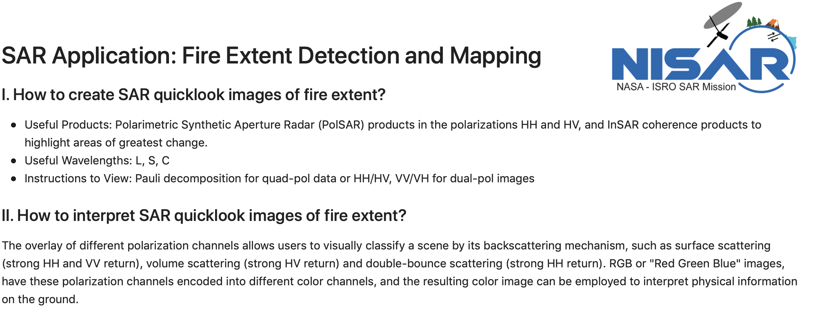
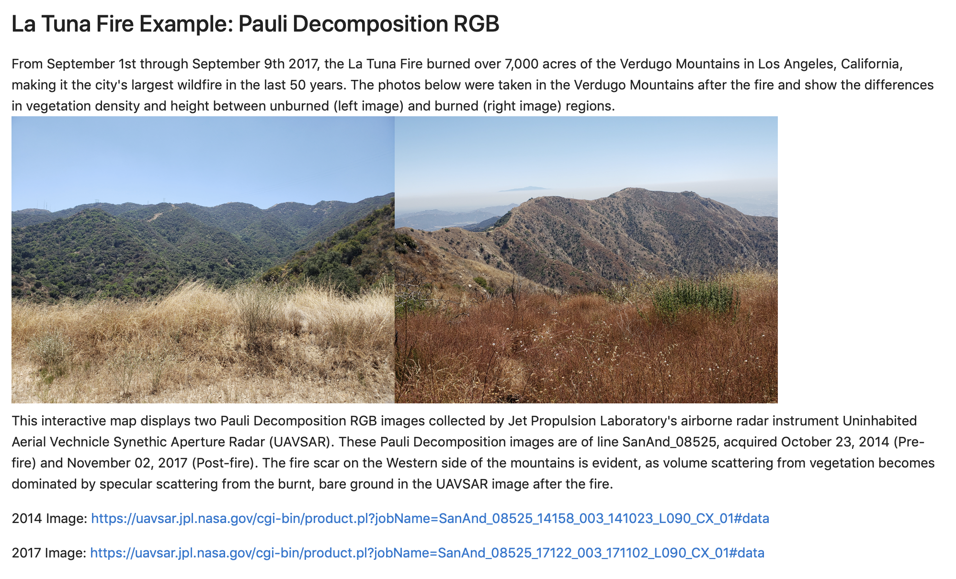
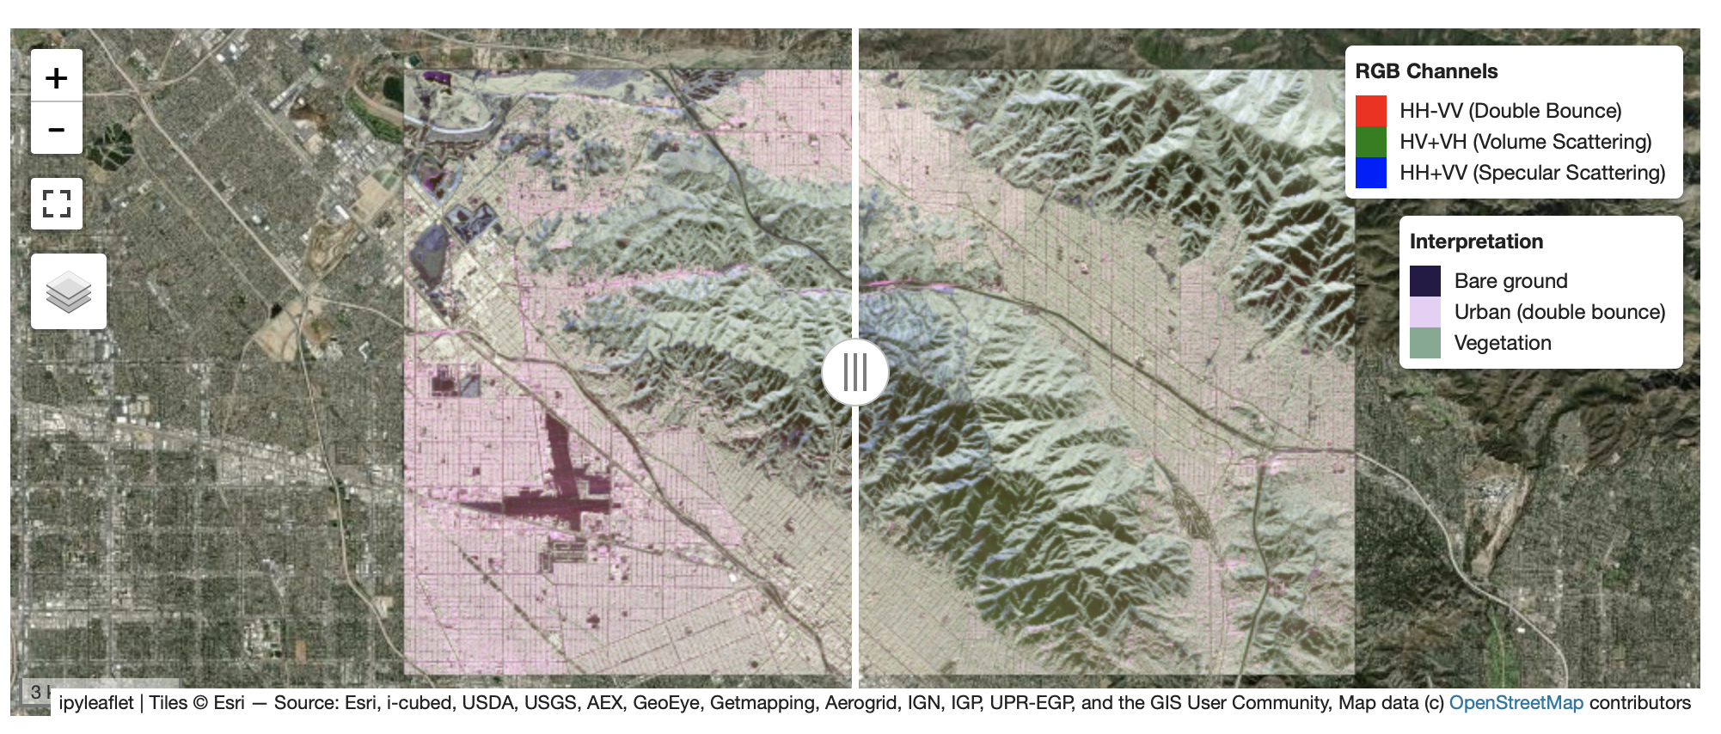
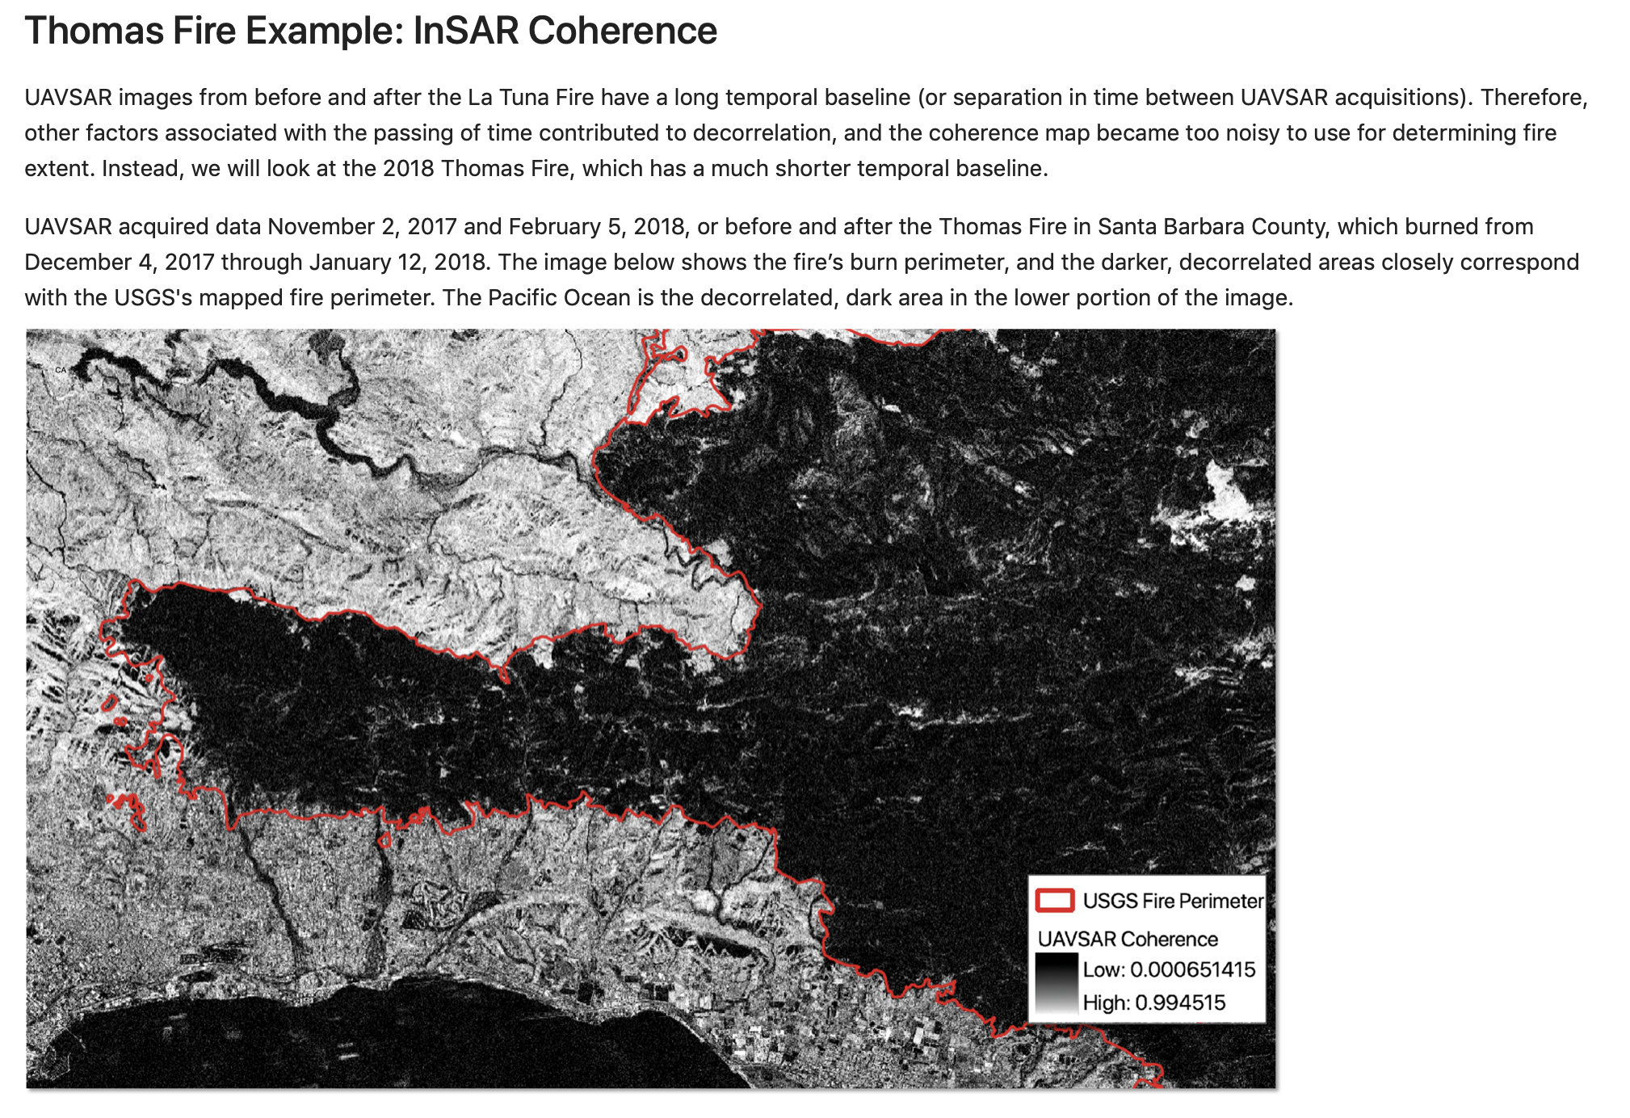
Fire Example
Section 1: Describe general processing and visualization guidelines for Fire Application
Section 2: Introduce La Tuna Fire Example with site pictures.
Interactive map Pre/Post Fire
Section 3: Look at Thomas Fire as an example of using coherence to look at fire extent
Flood: https://nisarquickloooks.herokuapp.com/voila/render/Flooding/Flood_Example.ipynb

Slide 70
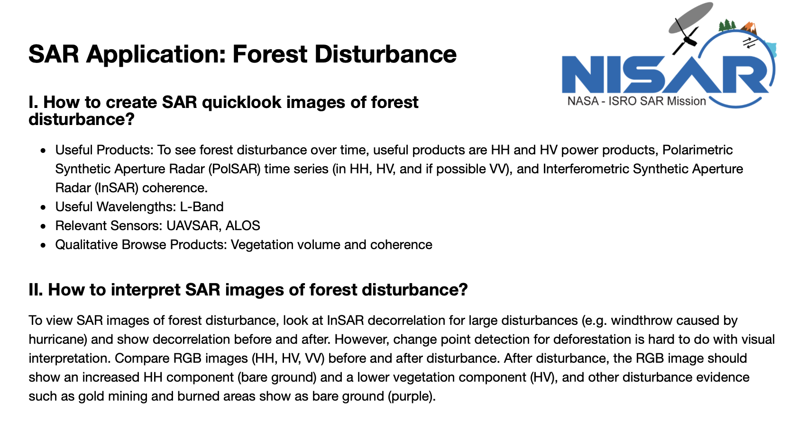
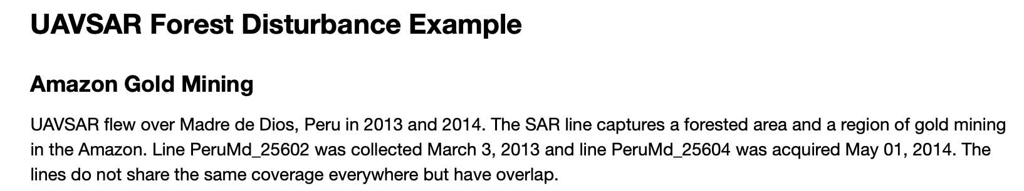
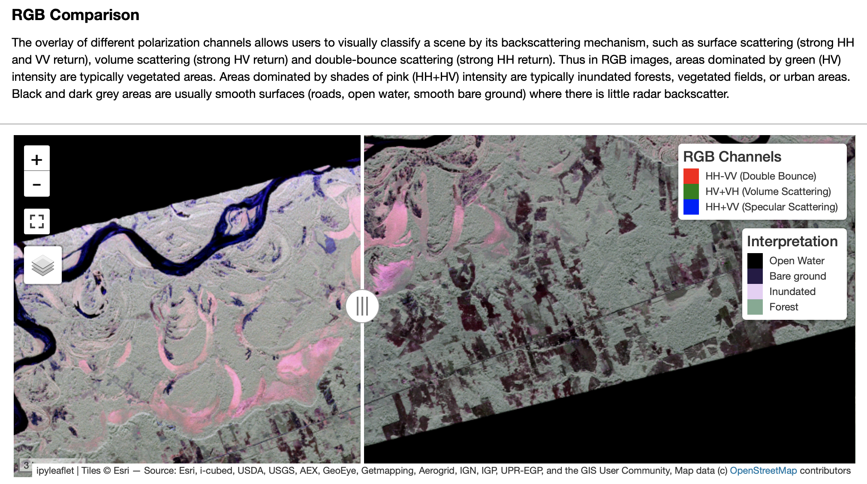
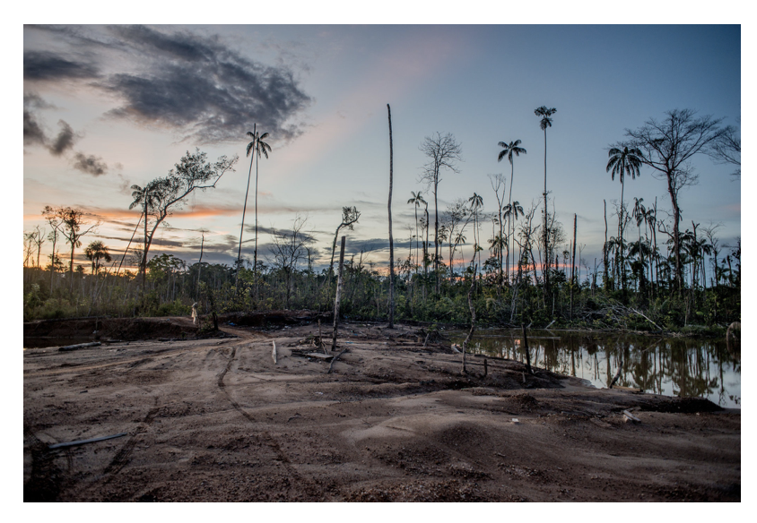
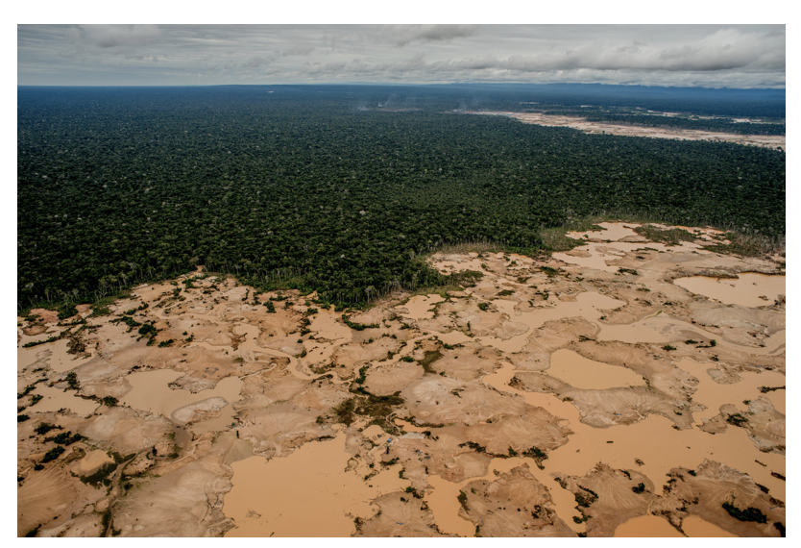
Forest Disturbance
Section 1: Describe general processing and visualization guidelines for Forest Disturbance Application
Section 2: Introduce Amazon Gold Mining Example. Includes example pictures and UAVSAR RGB map.
Section 3: TBD

Slide 71
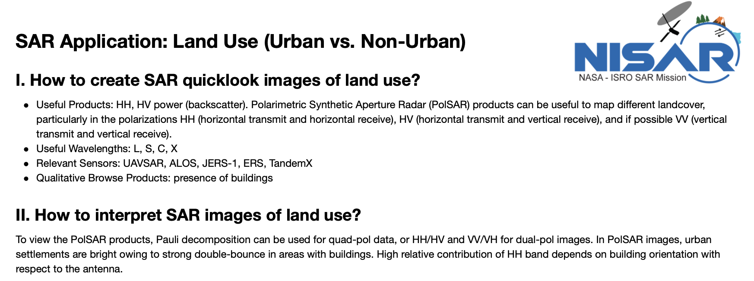
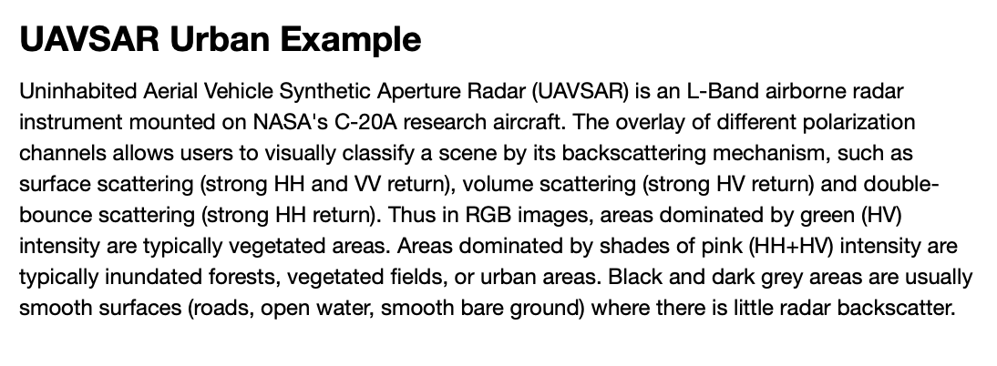
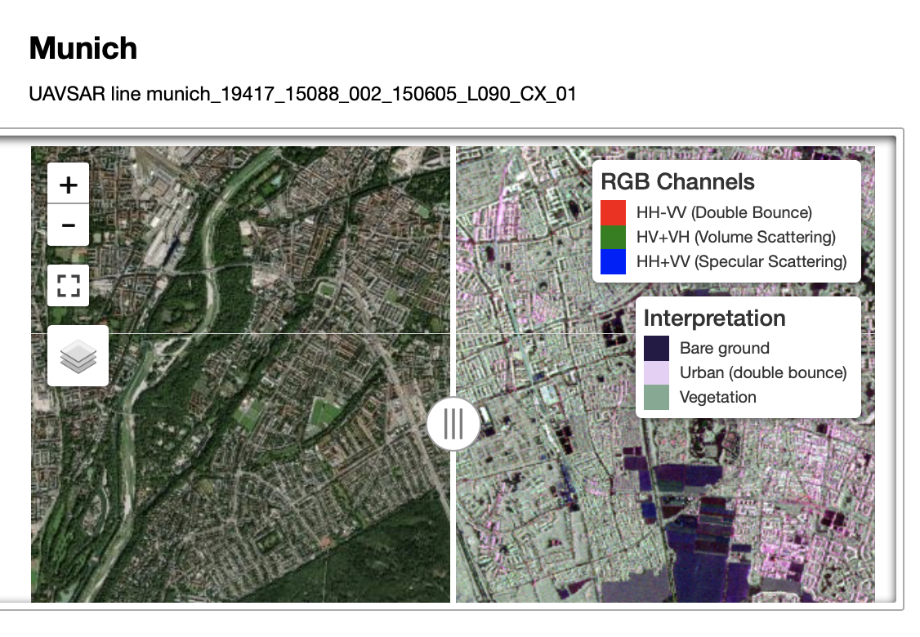
Land Cover
Section 1: Describe general processing and visualization guidelines for Urban vs Non-Urban Land Cover Applications
Section 2: Introduce Amazon Gold Mining Example. Includes example pictures and UAVSAR RGB map. Good UAVSAR examples also over Quebec, San Diego, New Orleans etc.
Section 3: TBD

Slide 72
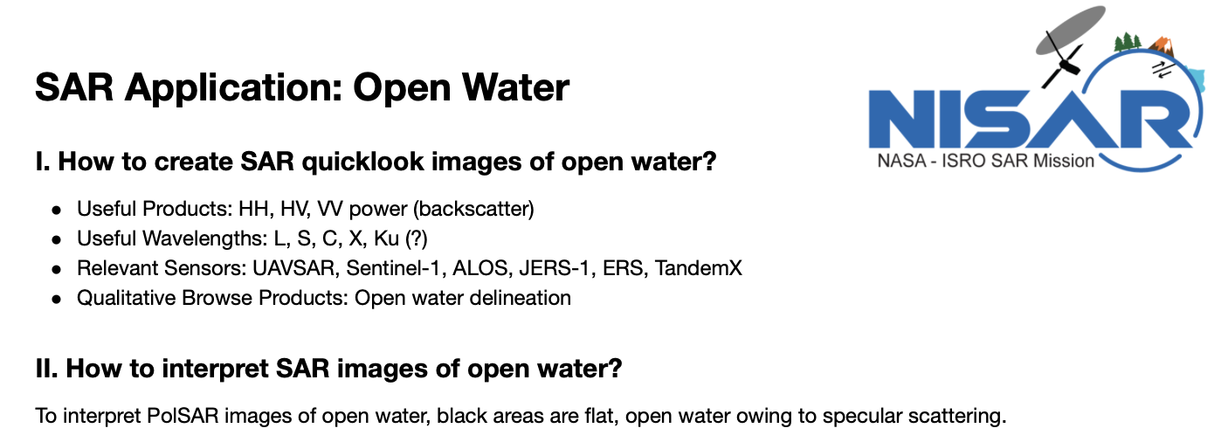
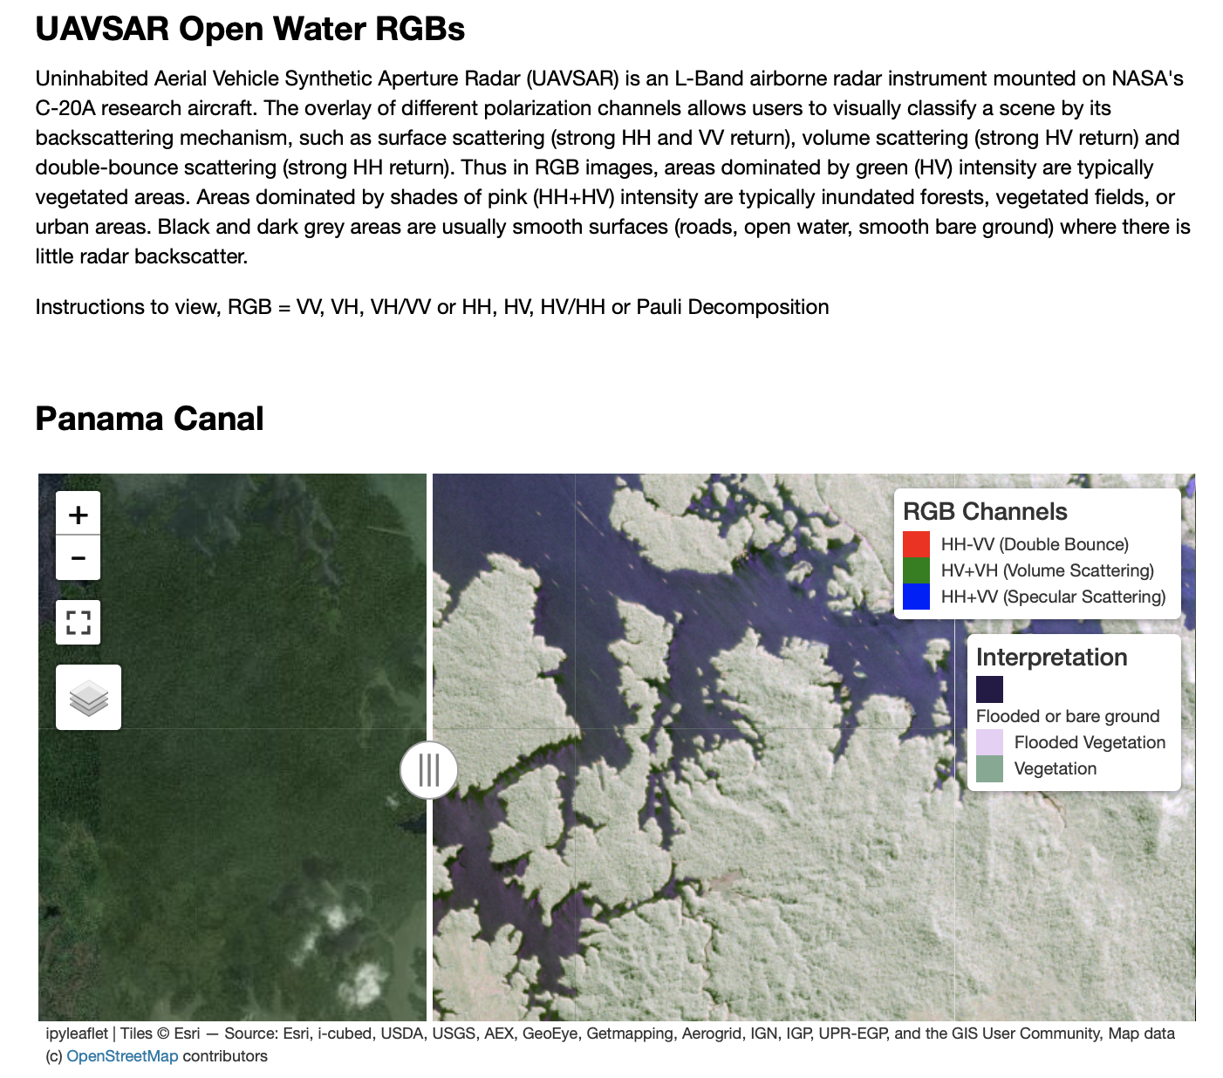
Open Water Extent
Section 1: Describe general processing and visualization guidelines for Open Water Applications
Section 2: Introduce Open Water Examples. Includes example pictures and UAVSAR RGB map. Good UAVSAR examples also over Yellowstone Lake, Crowley Lake, Peru etc.
Section 3: TBD

Slide 73
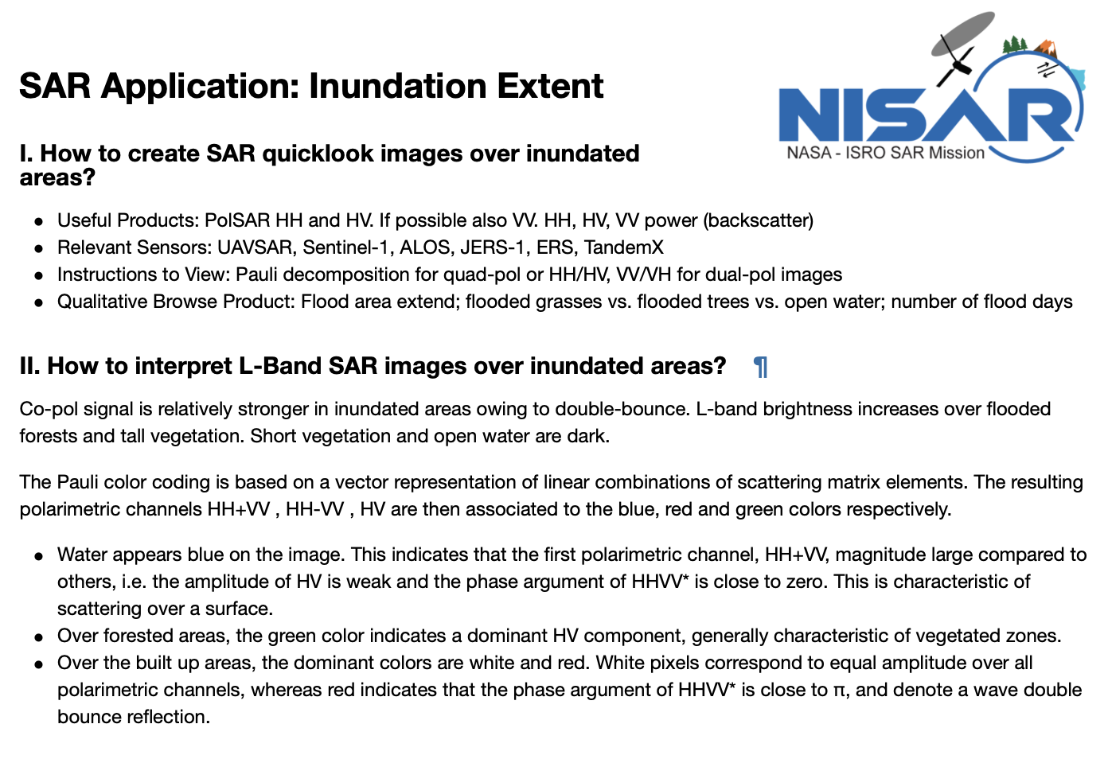
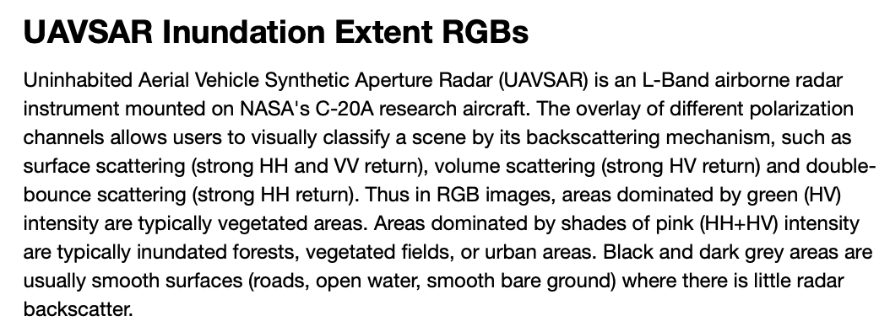
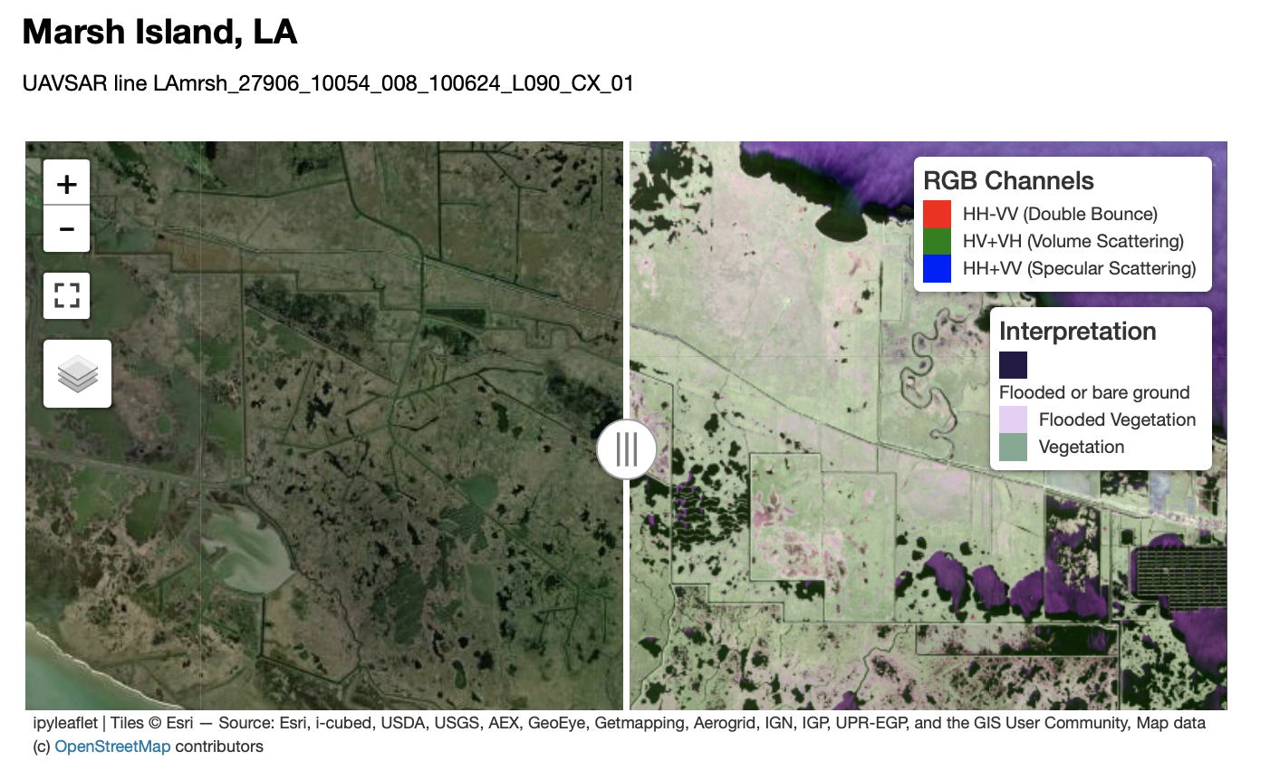
Inundation
Section 1: Describe general processing and visualization guidelines for Inundation
Section 2: Introduce Inundation Examples. Includes example pictures and UAVSAR RGB map. RGB UAVSAR examples also over Balona Wetland, Fay Slough Wildlife Area, Costa Rice Mangroves, etc.
Section 3: TBD

